Slide 1
MENTOR
Connecting lives

Slide 2
About Mentor
A platform that connects teachers to students and parents. An instant messaging app tailor made for communication between teachers,parents and students. It makes it easy for learners and instructors to connect inside and outside of schools. It saves time, improves organisation, and enhanced communication among the three categories

Slide 3
NEED

Slide 4
All parents may not be able to attend PTA meetings.
Most of them are unaware of their child's behaviour in class

Slide 5
FEATURES

Slide 6
TEACHER -PARENT COMMUNICATION
Student Mark List and Attendance Sharing
Keeps parents up-to-date about their child’s progress and behaviour
Announcements regarding school events
Personal chat with parents whose child needs special care

Slide 7
TEACHER - STUDENT COMMUNICATION
Instant note sharing
Assignment and project detail distribution
Notifications for school/classroom events
personal doubt clearing facility
Notifications regarding last date of submission of assignments and projects

Slide 8
WORKING

Slide 9
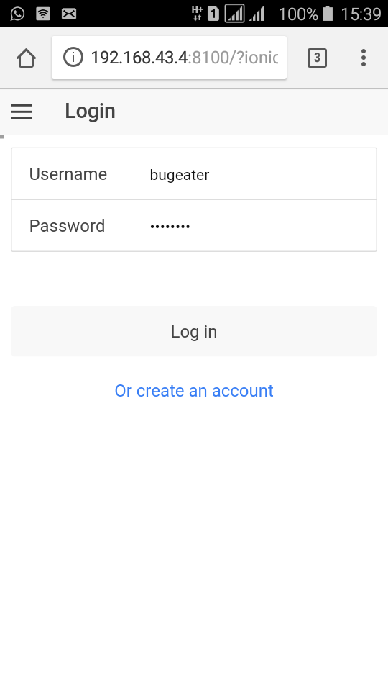
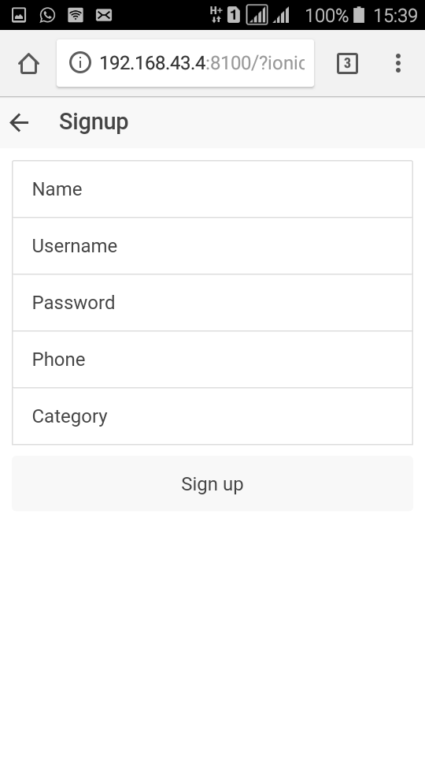

Slide 10
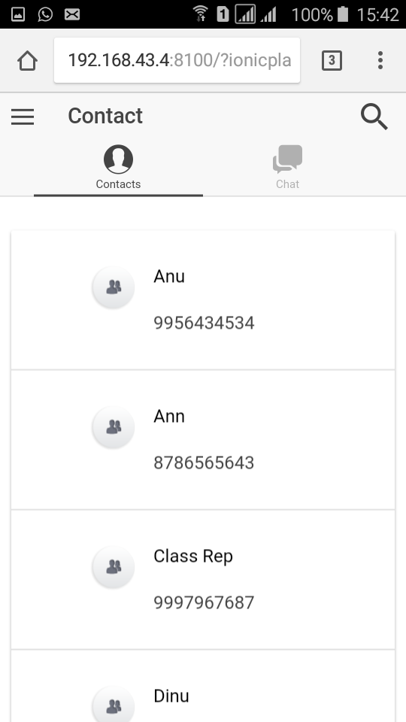
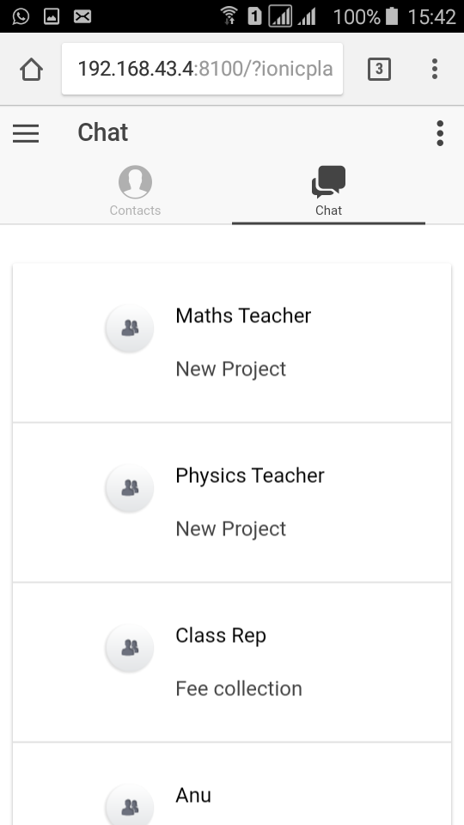

Slide 11
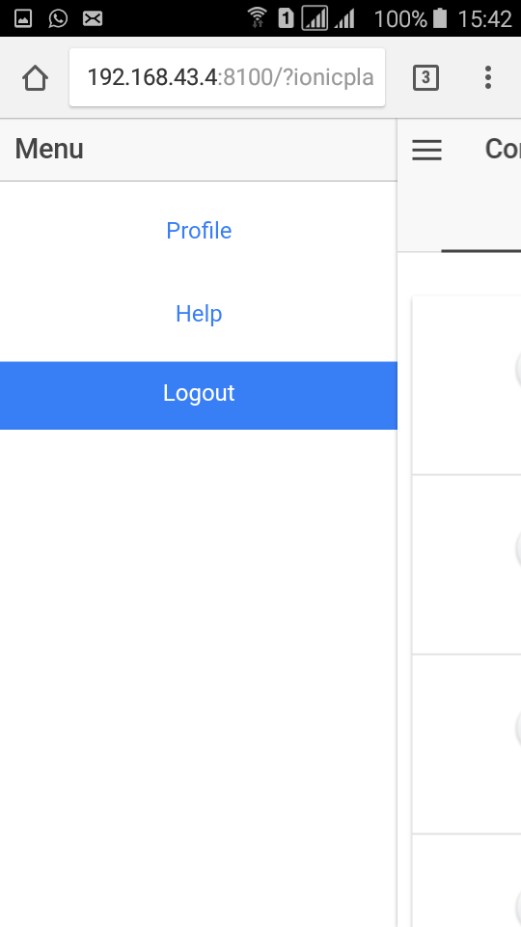
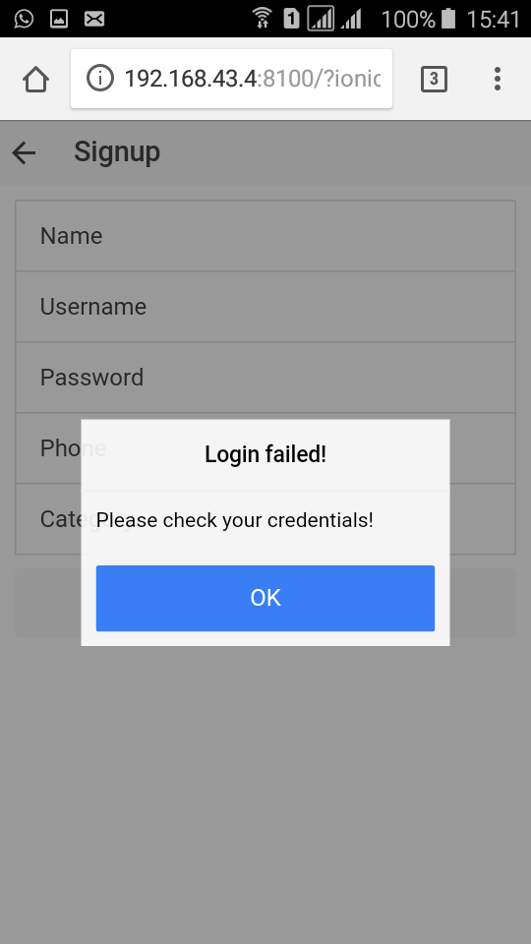

Slide 12
ADDITIONAL FEATURES THAT WILL BE ADDED IN FUTURE

Slide 13
Live video sessions
Audio messages
Push notifications
A feed where you find thousands of short-form articles.
Like or save the videos and facts you see in the feed
Downloading the videos for future references
Switch to light/dark mode from settings

Slide 14
Submitted by,
Abita Ann Augustine
Ananthakrishnan V K
Sarath K S
Safia E K

